Slide 1
>$ find / -name “teams.md”
Lab 02 – CS 411 @ Boston University

Slide 2
A Quick Recap…
Installing Git, Setting up SSH Key, Understanding the Workflow
Git Bash -> Windows
Terminal -> macOS, Linux
DO NOT SHARE YOUR PRIVATE KEY
Complete work on <username> branch
New branch per feature! (e.g. `git checkout –b feature/<name>`)
Explore the Lab Repository!
https://github.com/ArkashJ/CS411_labs/tree/main/Spring2024
Contains any resources shown and/or used during lab
If you have suggestions let me know!

Slide 3
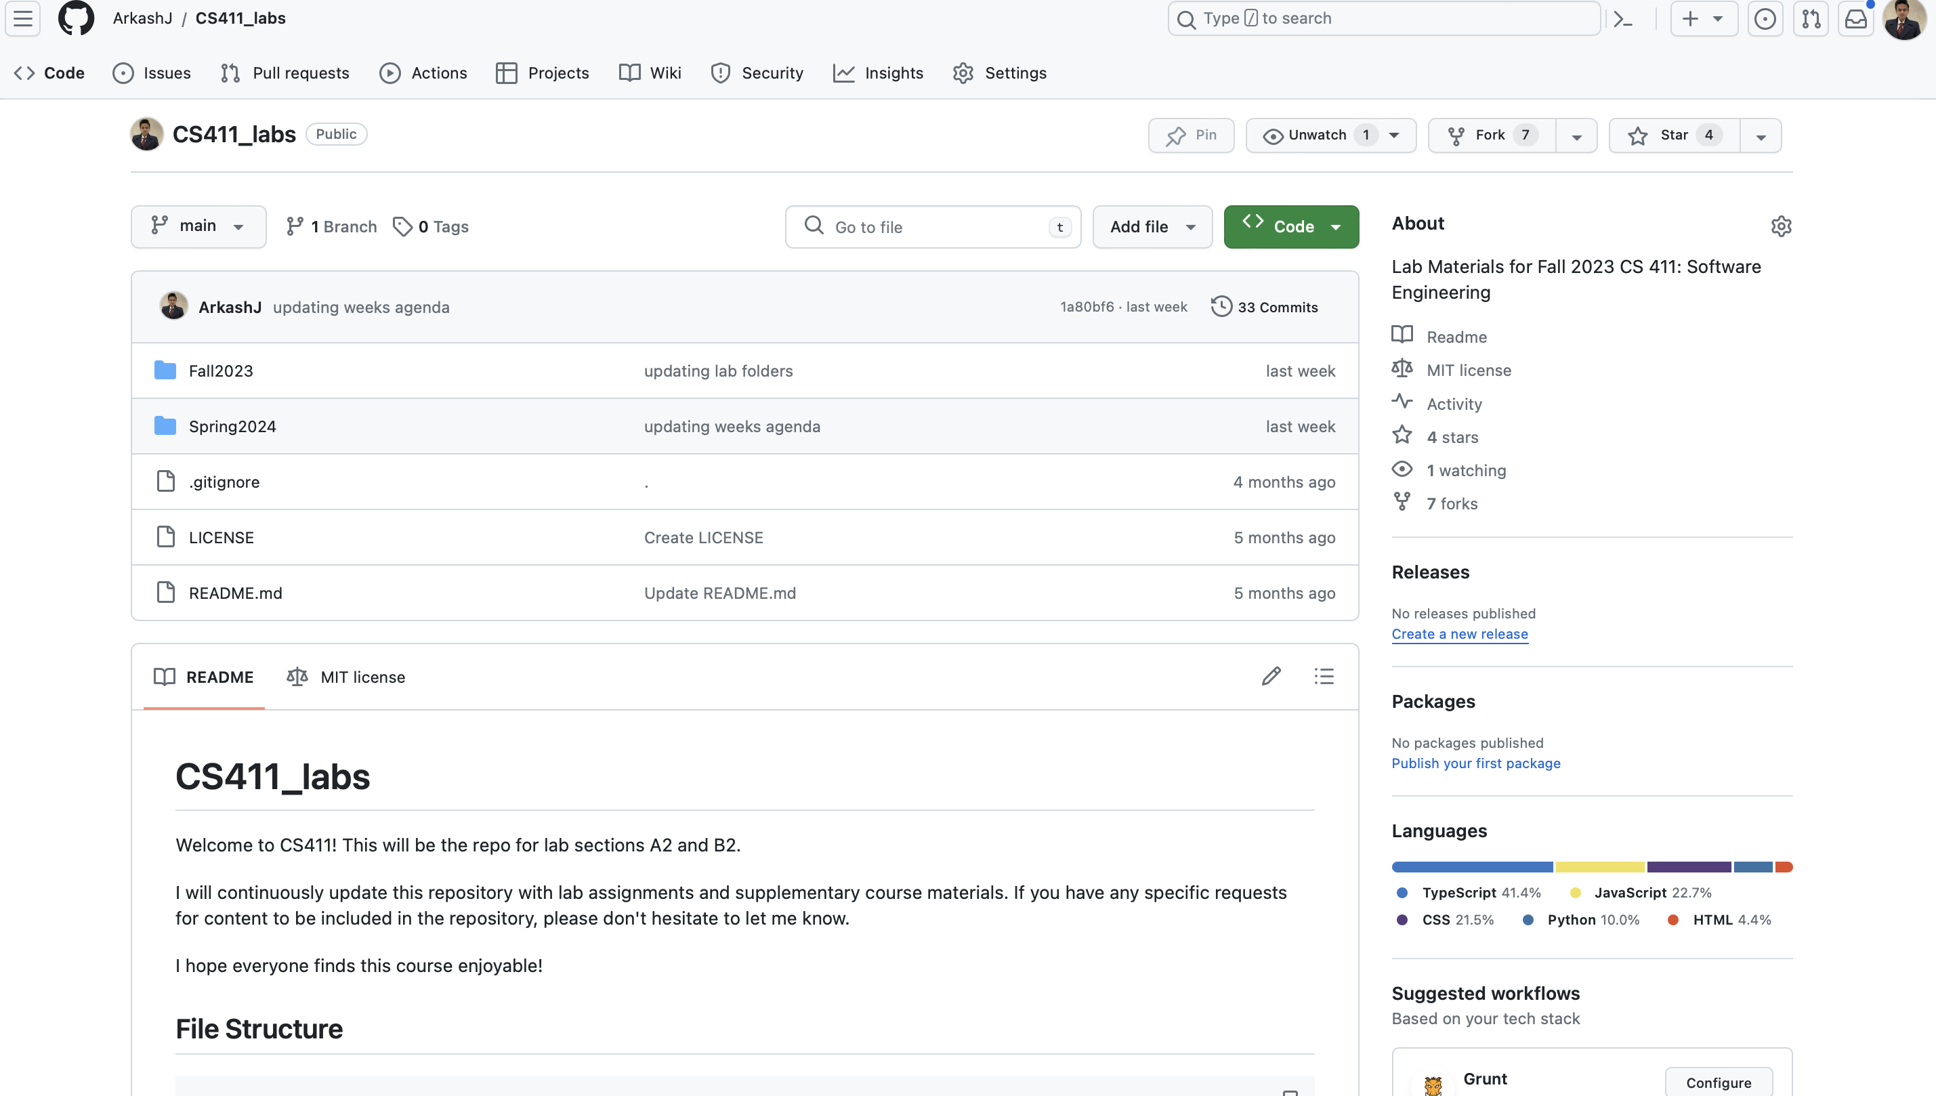

Slide 4
ASSEMBLE YOUR TEAMS!
Ladies and Gentlemen… The Moment You’ve All Been Waiting For…

Slide 5
Today’s Tasks!
First, please fill out this form so we know what your teams are!
https://docs.google.com/document/d/1I4q6jr8ZGGHIYZEd6wrJv17_xVewuF5dtWIzxwkPwzg/edit?usp=sharing
Next, I’m going to go over the expectation this semester and answer any questions.
I’ll also give you time to get familiar with your teammates and establish some methods of communication.
Find out what your team can and can’t do. In other words, play to each others' strengths!
Lastly, let’s get some ideas down! I’ll go over what was done in prior semesters, but it would be a good idea to start thinking now!

Slide 6
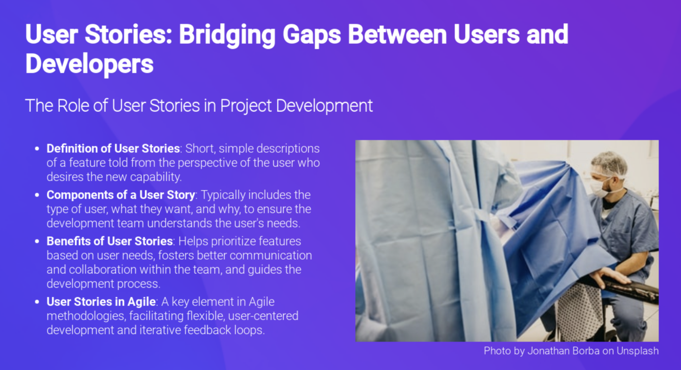
Getting Requirements

Slide 7
Case 1: Build a Photo Editing App
What features should it have?
Undo/Redo Mistakes
Crop, brightness – filtering and modification
Template feature – show examples of what people can do with the app
Import, saving, download
What actions can the user do?
Login to the app
Modify pictures
Save pictures
What data do I need?
Login – username, password
Pictures

Slide 8
CASE 2: Student Link
Whats wrong here?
Overcomplicated, overengineered
Hard to navigate
Not familiar
Old Student Link
Easy to use

Slide 9
CASE 3: DoorDash
Talk about the features:
Refunds
Location
Deals
Search Bar
Easy Navigation

Slide 10
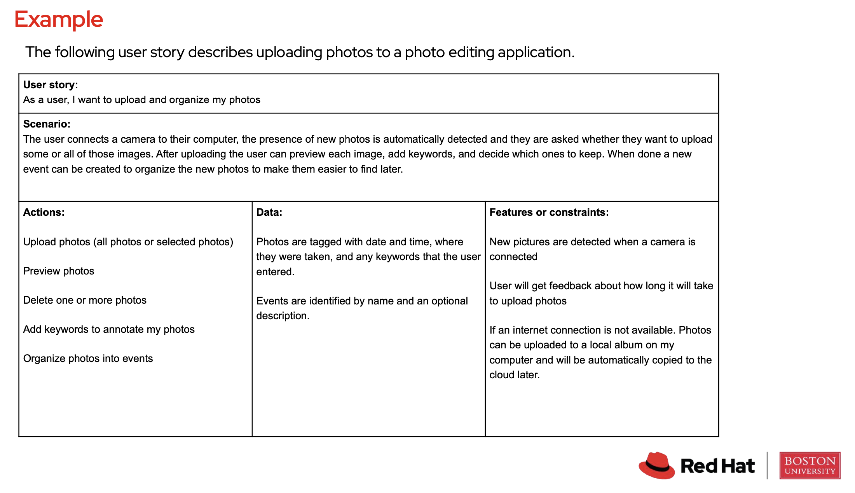

Slide 11
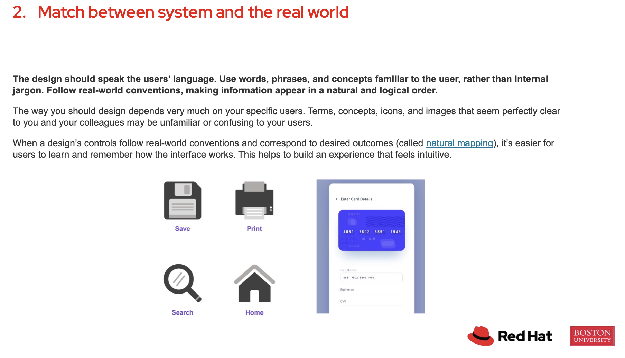
Make it Familiar and Easy!

Slide 12

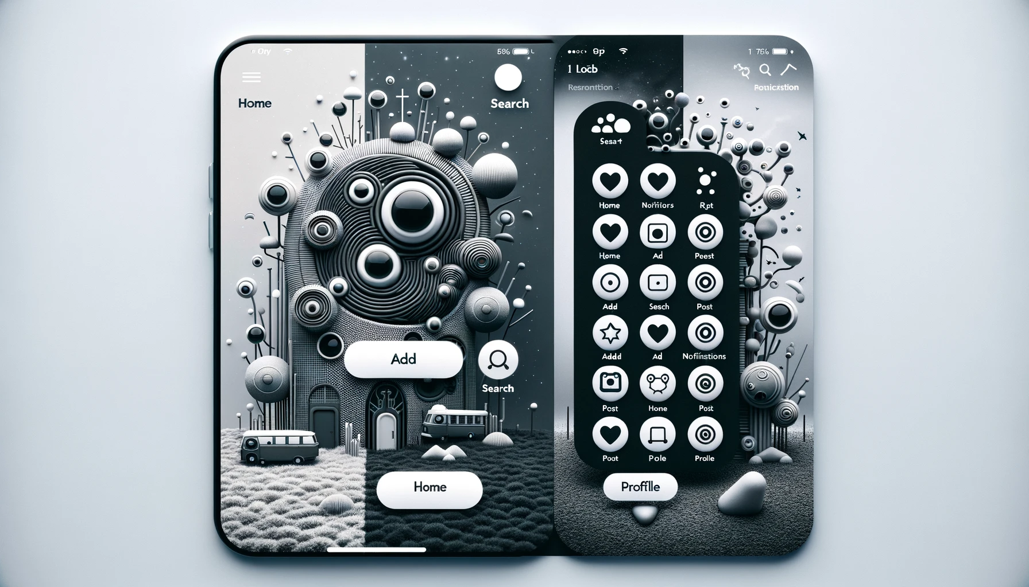
Which one would you rather have?

Slide 13
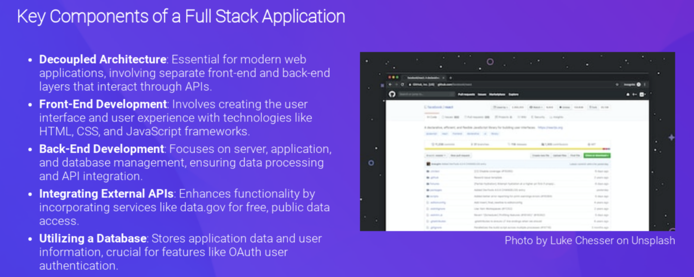
Choosing a stack

Slide 14
Project Requirements
It MUST have a decoupled architecture!
I.e., It must have a FRONT END and a BACK END
Make calls to TWO external API’s
These can literally be ANYTHING you want
I personally like https://data.gov/ because it’s simple and free!
(Ok well not exactly your tax dollars pay for it…)
Utilize a DATABASE, again dealers' choice here
Have OAuth, meaning allow users to signup and login
You actually need a database for this to store credentials

Slide 15
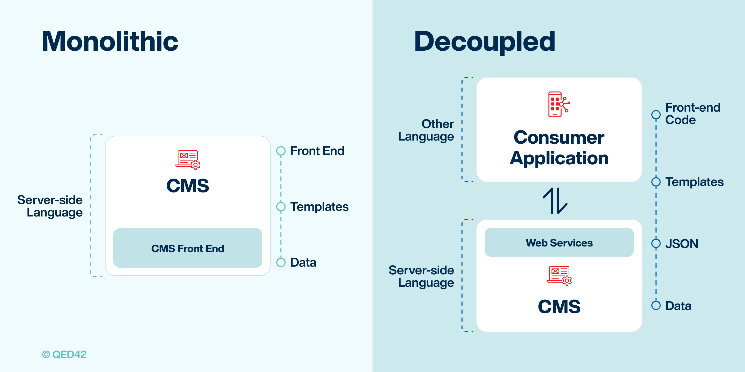
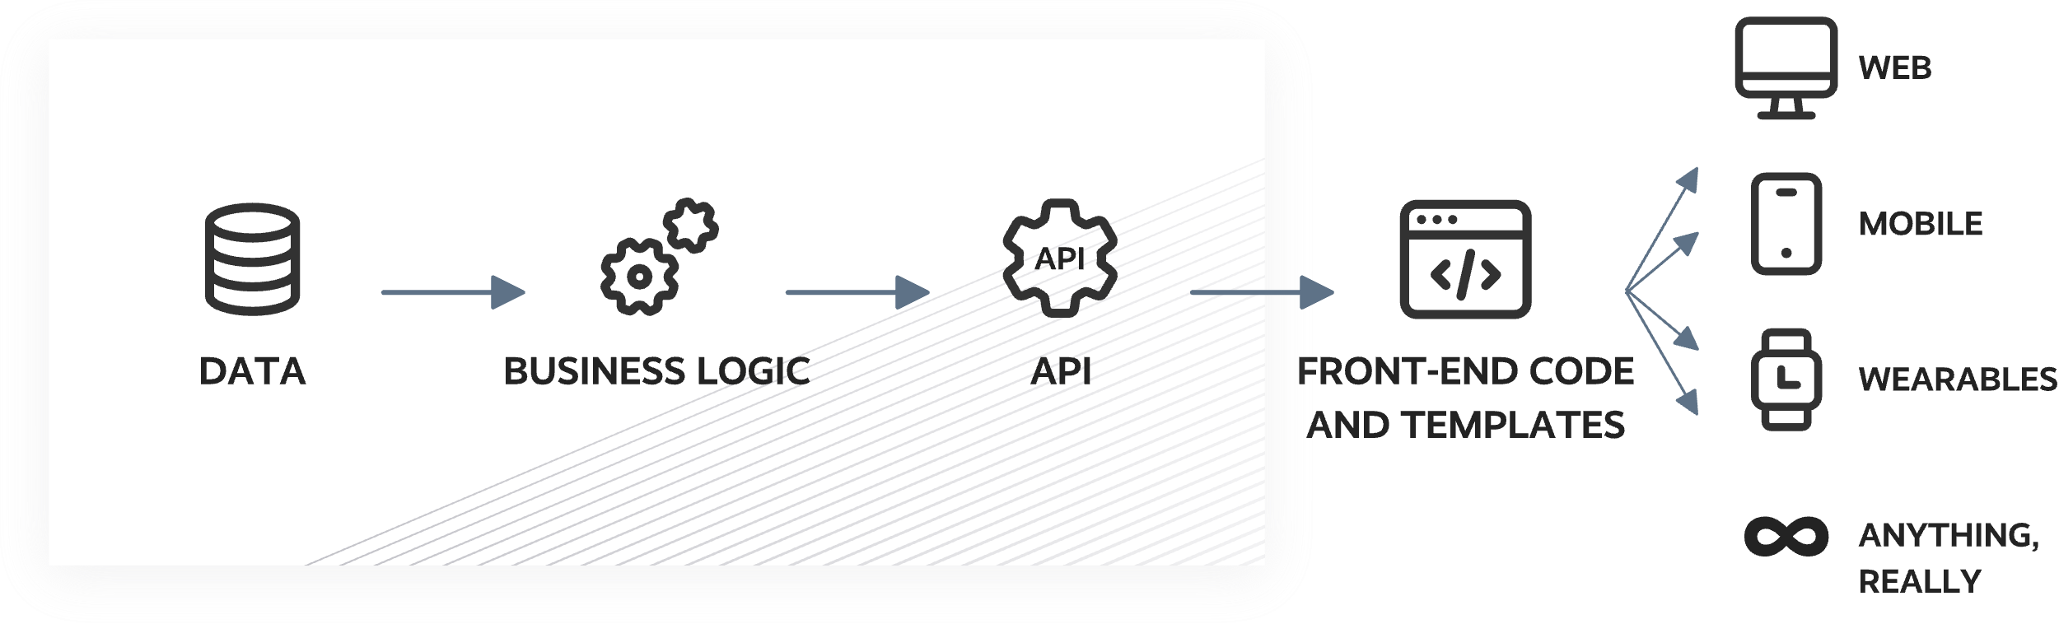
Why is hiding data useful?

Slide 16
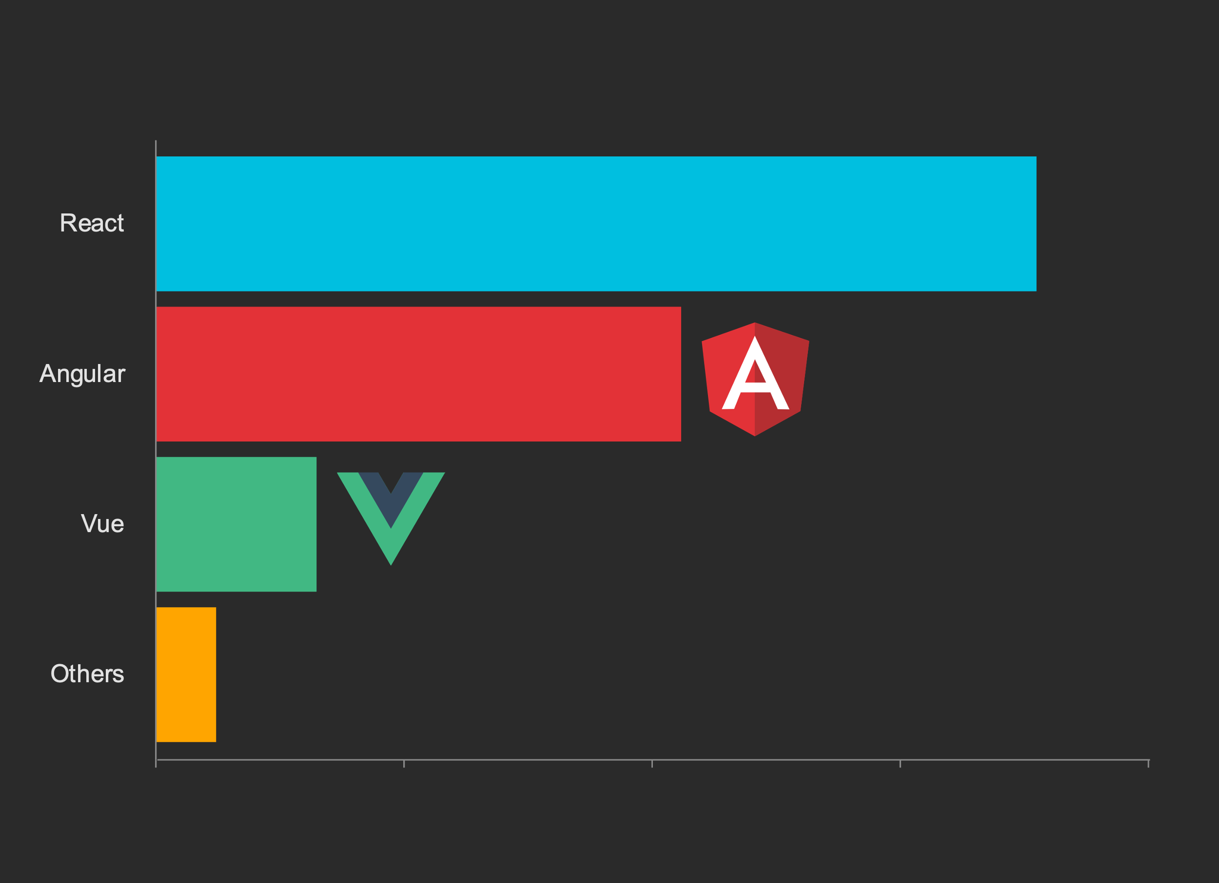

Frontend
This is what the user sees and interacts with

Slide 17
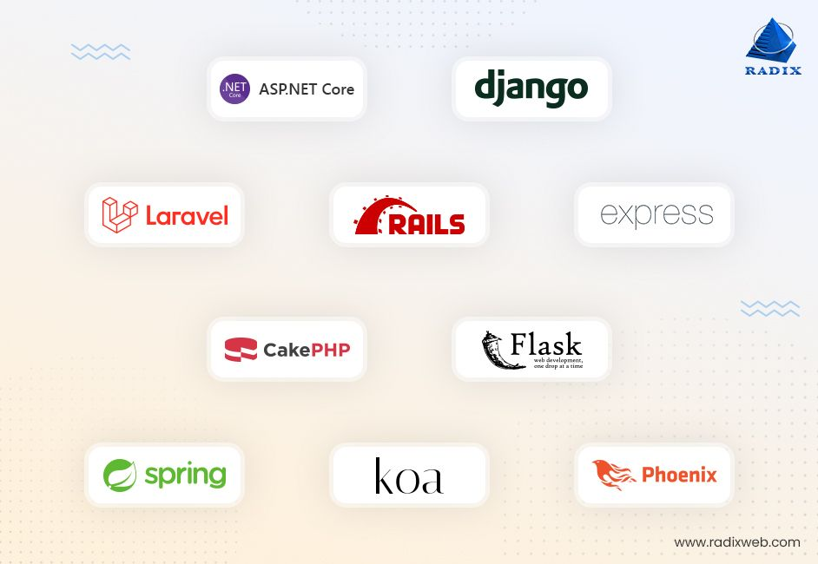
Backend

Slide 18
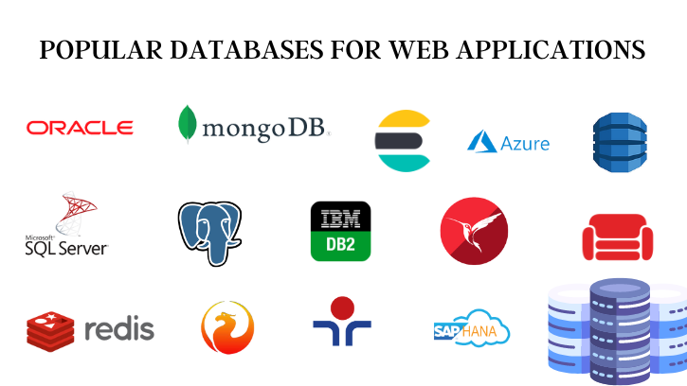
Database

Slide 19







Get Those Comms Up Soldier!

Slide 20



RESOURCES! Oh… Uh… And me of course!

Slide 21
git add lab02.txt git commit –m “complete” git push origin master
Lab 02 – CS 411 @ Boston University
(dcmag@bu.edu)

